Slide 1

MintTrack
By Jeff Titus
Christopher C. Wilkins
Stephen Krach
Pablo BajoLaso

Slide 2
The Question: Where is my money going?
Tracking spending on a daily basis can be a tedious and grueling process
No one has time to sit down everyday and write down what they spent their money on.
People often times forget what they spend their money on before they can log it
It’s time to let go of the stone age methods of tracking our spending!
Spending needs to be logged the moment we make a purchase
The one device we almost always have with us is our cell phone

Slide 3
Introducing The Cure: MintTrack! Exclusively for Android
Keep track of your daily spending quickly and easily on your Android powered device
Control: Take back the control of where your money is going with MintTrack’s ability to track your spending by categories
Visualize: Visualize your spending habits more easily with easy to use graphing
Sanity: Feel better knowing where your money is going and save more money knowing where you could spend less.

Slide 4
The Details
The Language: JAVA
The Platform: Android 1.6 API
The Data: Stored in SQLite
Product Goal: To provide a tool that effectively allows a person to track their spending habits and to know where their money is really going.
Group Goal: To become proficient Android Developers and to leave the project with the ability to develop useful applications for the Android Platform

Slide 5
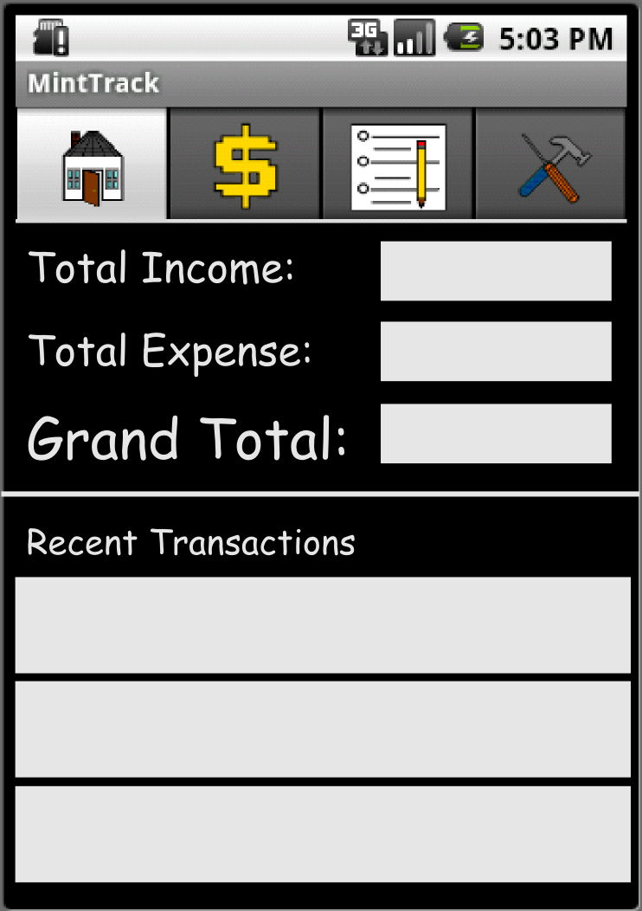
How’s it Work? Home
We live in a fast paced world and often times we just want the bottom line
The Home screen is MintTrack’s bottom line
The summary provides recent transactions, and the overall totals.

Slide 6
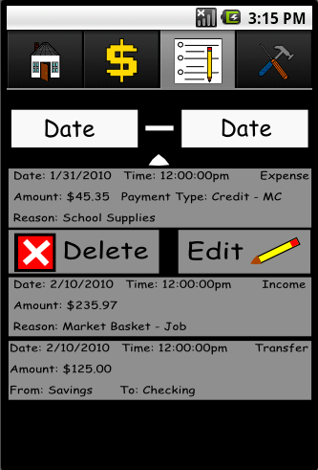
How's it work? The Summary
When you need to view your history in a refined way the audit screen is the place to go
From the audit screen the user is able to review his or her overall transaction history
The summary screen allows a user to edit and delete any previous transaction created.
View your spending history based on your terms. View By Category/Date Range/Amount.

Slide 7
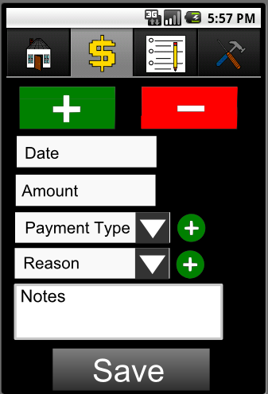
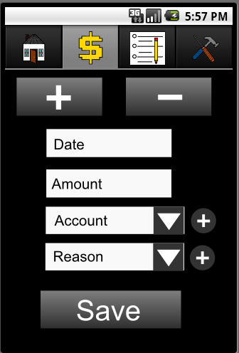
How’s it work? Transaction Entry
Easily enter your income and expenses
Add a note to keep track of why you are spending money
Dynamically add reasons, payment types, account at will
Predate your transactions in the event you forgot to add something

Slide 8
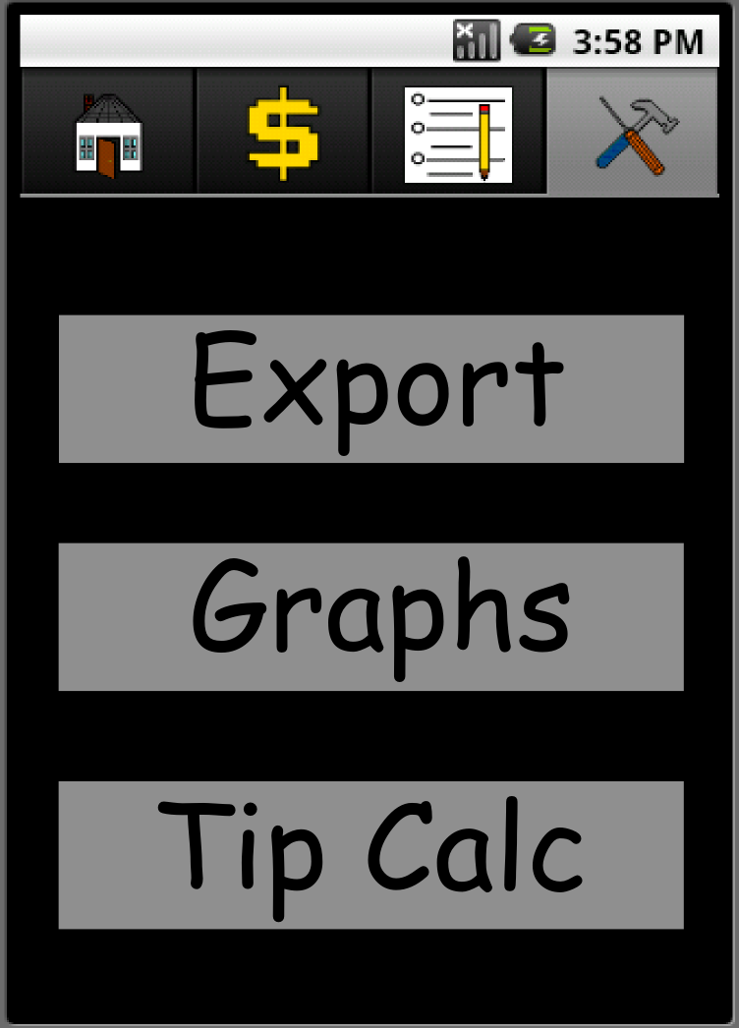
How’s it work? Tools
Provides the ability to export the user’s data to CSV format
Graphs: Execute graphic rendering of your spending
Tip Calculator: YATC (Yet Another Tip Calculator)

Slide 9
Conclusion
MintTrack provides a facility to easily keep track of personal finances
The Android Mobile device is the ideal place for us to keep track of spending because it is with us at all times
Categorizing your spending habits helps you plan for the future and detect expensive spending habits.
Have the information you need at your finger tips. Savings, checking, expense habits, and much more right in your pocket.

